Slide 1
Online One Week Short Term Training Programme on Python Programming.
Prepared By,
A.Thomas Mary Sheeba,AP/IT

Slide 2
CONTENTS
Modules
Packages
Command Line Argument

Slide 3
MODULES
Module is file consisting of related python functions as single file.
Module can define functions, classes and variables
Uses of Module:
Break down large programs into small manageable files
Reusability of Code

Slide 4
TYPES OF MODULES
Two Types
1.Built-in Modules
Already Defined
2.User Defined Modules
Define our own Modules

Slide 5
Example for Built-in Function
import math # math module, contain all mathematical functions
a=int(input(“enter a number”))
st=math.sqrt(a) # sqrt is a function available in math module
print(st)

Slide 6
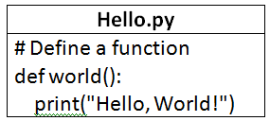
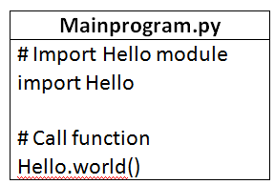
User Defined Module
Creating our own modules.
Example:

Slide 7
from import statement
It is possible to import any specific function from a module using from import statement
Ex:
from math import sqrt # import only the sqrt function from math module
a=int(input(“enter a number”))
st=math.sqrt(a)
print(st)
from math import *

Slide 8
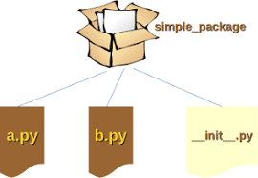
PACKAGES
Package is a directory.
This holds subpackages and modules.
Must contain _init_.py

Slide 9
Command Line Argument

Slide 10
Command Line Argument
Command Line Interface(CLI) – user to interact with a program running in text-based shell interpreter.
Command Prompt on Windows.
While executing the program, command line arguments are given along with program name.

Slide 11
Command Line Argument
In Python, function supporting command line arguments are placed in sys module.
While using command line arguments, sys module should be imported.
import sys
Sys module contains specific parameters and functions.

Slide 12
Functions in sys module
Sys.argv
Sys.builtin_module_names
Sys.copyright
Sys._clear_type_cache()
Sys.dllhandle
Sys.exc_clear()

Slide 13
Sample Program
import sys
count=len(sys.argv)
print ("The number of arguments is:",count)
for i in range(count):
print ("The argument is",sys.argv[i],"length is”, len(sys.argv[i]))
Output:
python one.py hai come here
The number of arguments is: 4
The argument is one.py length is 6
The argument is hai length is 3
The argument is come length is 4
The argument is here length is 4
Note: The first argument is the file name.

Slide 14
Numpy – Numerical Python
Array Processing Package
High performance for Multidimensional Array Object
Scientific Computing
Features:
N – dimensional array object
Tools for integrating C/C++ and Fortran code
Useful in Linear Algebra, Fourier Transform, Random Number Capabilities.

Slide 15
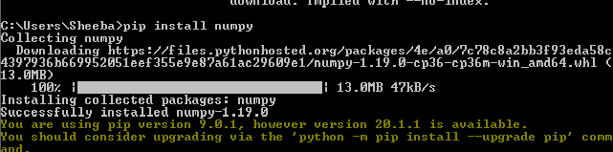
Numpy Installation
>>> pip install numpy
>>> import numpy
If not installed, shows an error message.
ImportError: No module named 'numpy'

Slide 16
Creation of Array
N – dimensional array type called ndarray.
Collection of items of same data type.
Zero based index.
Syntax: numpy.array
Arguments:
numpy.array(object, dtype = None, copy = True, order = None, subok = False, ndmin = 0)

Slide 17
Array attributes of NumPy.
ndarray.shape
returns a tuple consisting of array dimensions. Used to resize an array.
Eg 1:
import numpy as np
a = np.array([[1,2,3],[4,5,6]])
print( a.shape) # output: (2,3)
Eg 2: # this resizes the ndarray
import numpy as np
a = np.array([[1,2,3],[4,5,6]])
a.shape = (3,2)
print (a)

Slide 18
ndarray.ndim
This array attribute returns the number of array dimensions.
Eg:
import numpy as np
a = np.arange(24)
print (a)
print(a.ndim)
Output:
[0 1 2 3 4 5 6 7 8 9 10 11 12 13 14 15 16 17 18 19 20 21 22 23]
1

Slide 19
numpy.itemsize
returns the length of each element of array in bytes.
Eg:
# dtype of array is int8 (1 byte)
import numpy as np
x = np.array([1,2,3,4,5], dtype = np.int8)
print (x.itemsize) Output: 1

Slide 20
numpy.empty
It creates an uninitialized array of specified shape and dtype.
Eg:
import numpy as np
x = np.empty([3,2], dtype = int)
print (x)
Output:
[[22649312 1701344351]
[1818321759 1885959276]
[16779776 156368896]]

Slide 21
numpy.zeros
Returns a new array of specified size, filled with zeros.
Eg:
# array of five zeros. Default dtype is float
import numpy as np
x = np.zeros(5)
Print( x)
Output:
[ 0. 0. 0. 0. 0.]

Slide 22
numpy.ones
Returns a new array of specified size and type, filled with ones.
Eg:
# array of five ones. Default dtype is float
import numpy as np
x = np.ones(5)
print( x)
Output:
[ 1. 1. 1. 1. 1.]

Slide 23
Matplotlib
Plotting library for Python
Used along with numpy
Alternative for matlab
Graphics toolkits
Install
pip install matplotlib

Slide 24
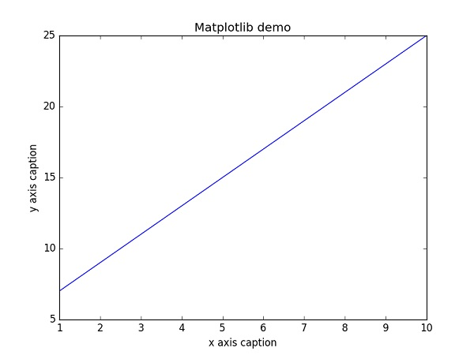
pyplot – plot()
This is used to plot 2D data.

Slide 25
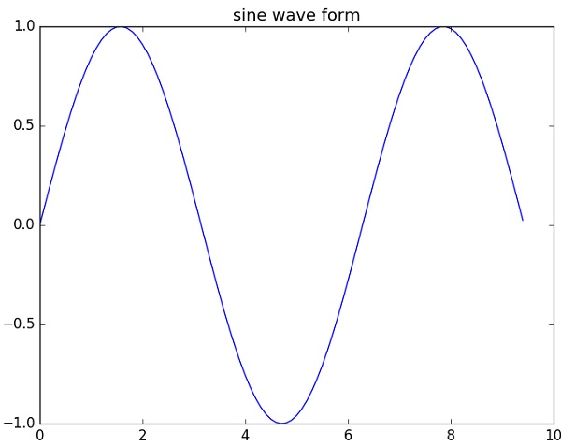
Sin()
Sine wave plot

Slide 26
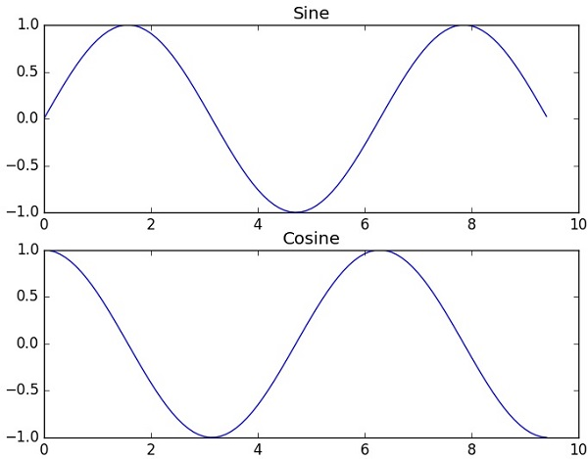
Subplot()
plot different things in the same figure.

Slide 27
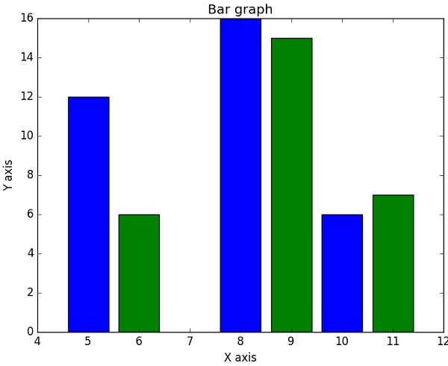
Bar()
This generates bar graph.

Slide 28


Slide 29


